Slide 1
Coursera Capstone Project
Investment for a Hotel
Using Foursquare API
Finding Neighborhoods of Target location
Analysis of Neighborhood
Select the investment Area

Slide 2
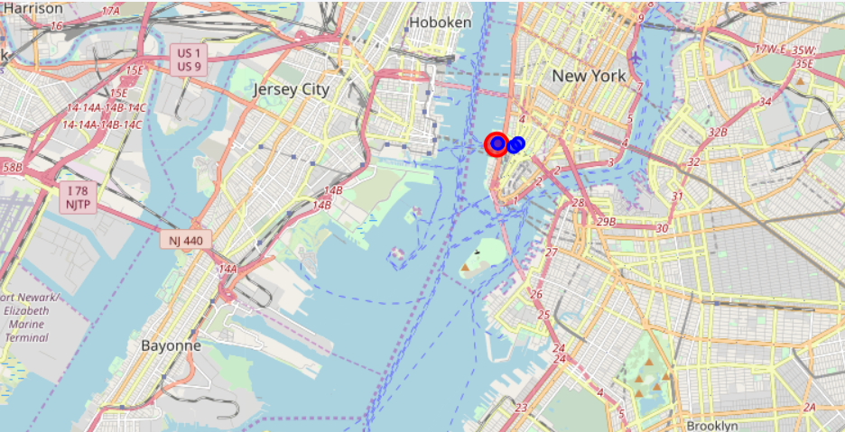
Coursera Capstone Project
Finding Neighborhoods of Target location

Slide 3
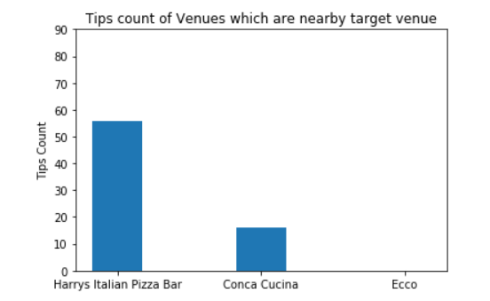
Coursera Capstone Project
Tips count of Neighborhood

Slide 4
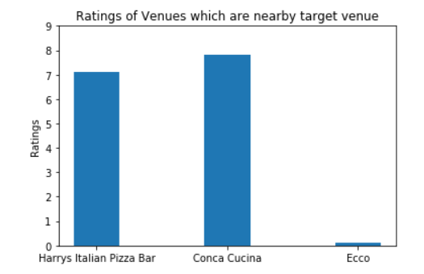
Coursera Capstone Project
Rating of Neighborhood

Slide 5
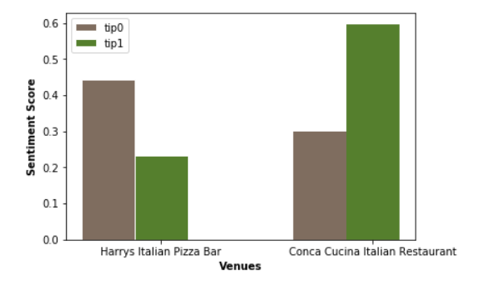
Coursera Capstone Project
Sentiment Analysis of Neighborhood

Slide 6
Coursera Capstone Project
Conclusion
The conclusion is that the restaurent which is closest to the target location is having less positive sentiment score while other one are a little far but one of them is having high rating and good positive sentiment score. It means we can get findings from that restaurent and open another in nearby location to the target.

